Slide 1
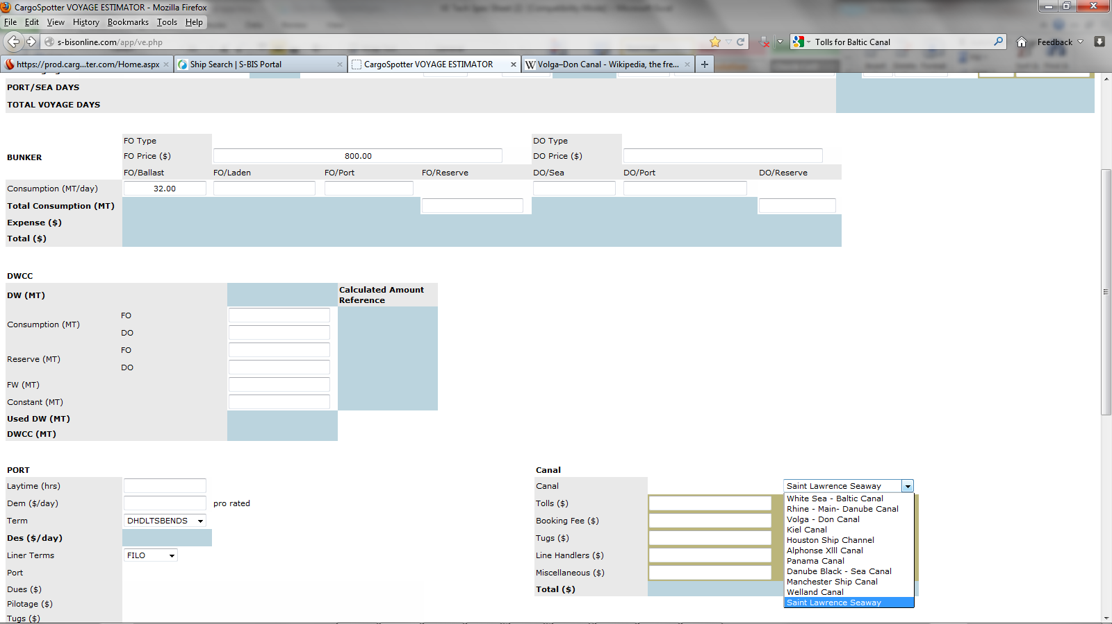
Missing Some Canals??? Especially Suez? ☺
Canals
White Sea - Baltic Canal
Rhine - Main- Danube Canal
Suez Canal
Volga - Don Canal
Kiel Canal
Houston Ship Channel
Alphonse Xlll Canal
Panama Canal
Danube Black - Sea Canal
Manchester Ship Canal
Welland Canal
Saint Lawrence Seaway
Canals
White Sea - Baltic Canal
Rhine - Main- Danube Canal
Suez Canal
Volga - Don Canal
Kiel Canal
Houston Ship Channel
Alphonse Xlll Canal
Panama Canal
Danube Black - Sea Canal
Manchester Ship Canal
Welland Canal
Saint Lawrence Seaway

